Slide 1
“The most pathetic person in the world is
some one who has sight but no vision.” ― Helen Keller

Slide 2
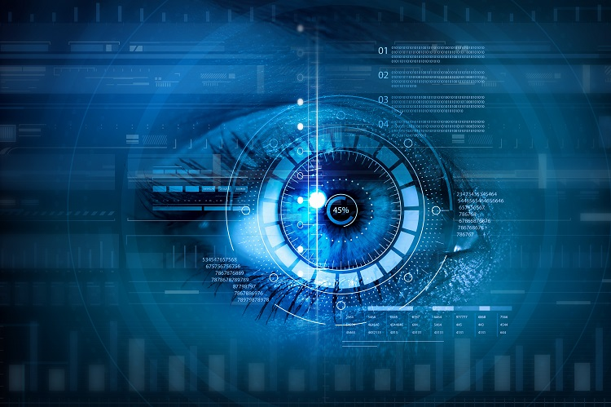
Computer Vision
By:-
M Shvejan Shashank
18311A05M3

Slide 3
What can a computer do with the power of vision

Slide 4
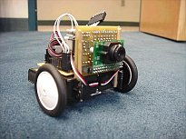
Robotics:-

Slide 5


Slide 6


Slide 7
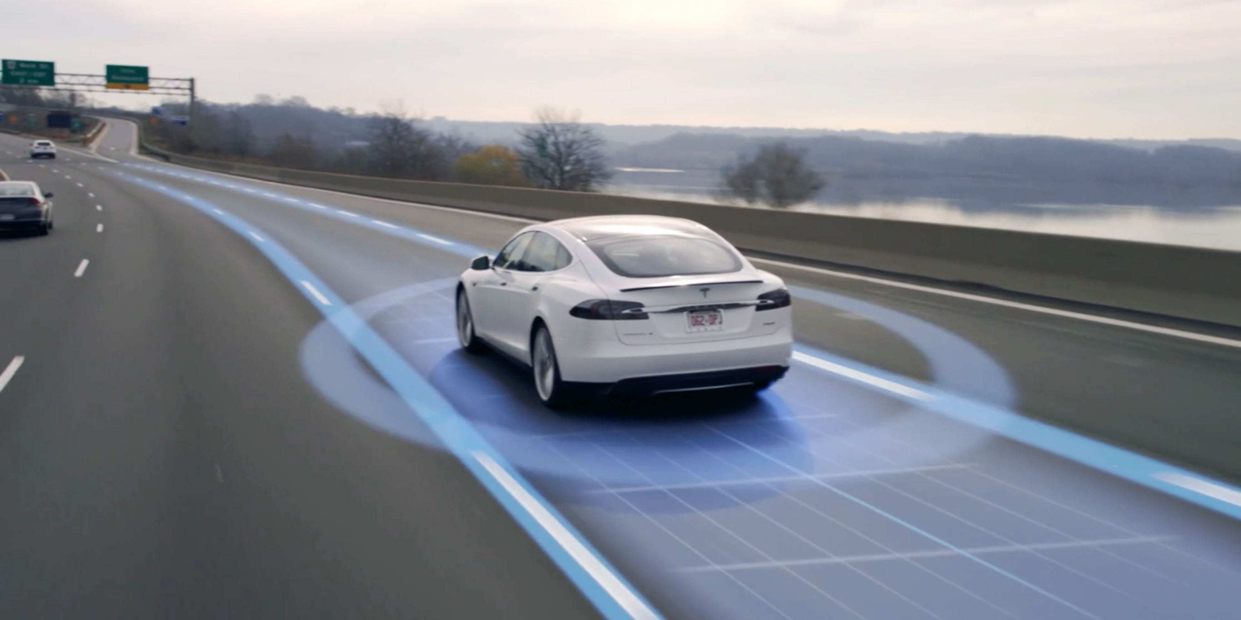

Slide 8
Video

Slide 9
Things to be considered:-
White line on the right
Yellow line on the left
Things that are not requited:-
Trees
Sky
grass
Etc…

Slide 10
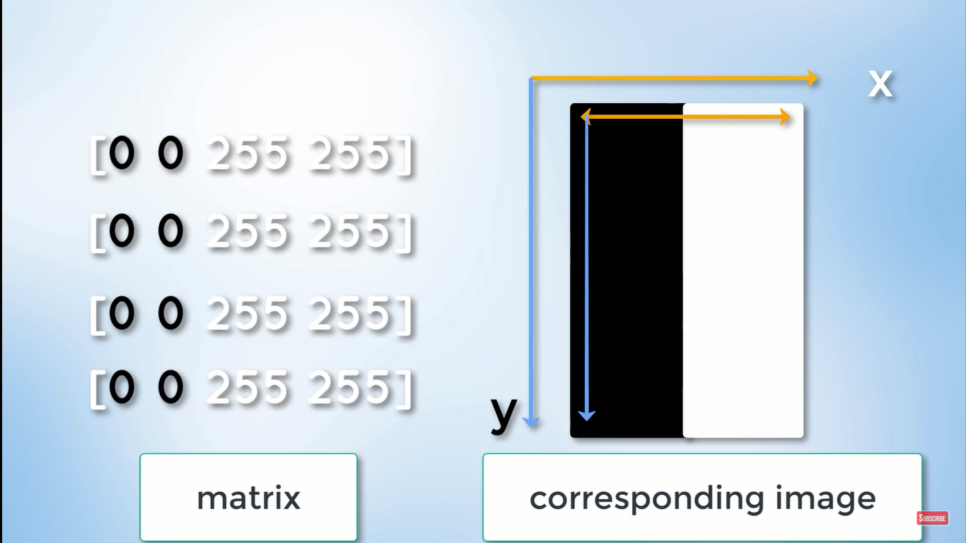
Canny filter:-
This filter is used to detect edges

Slide 11
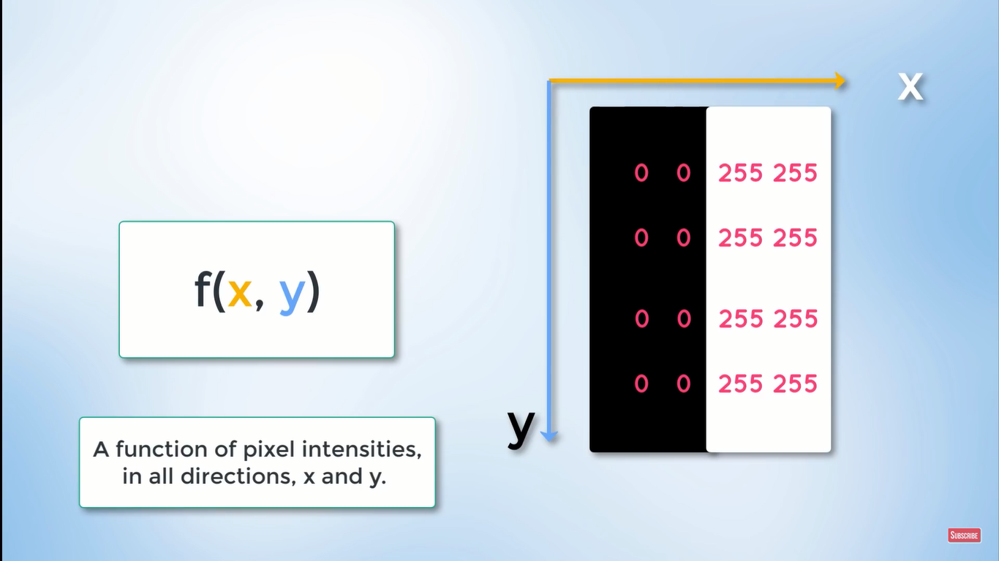

Slide 12
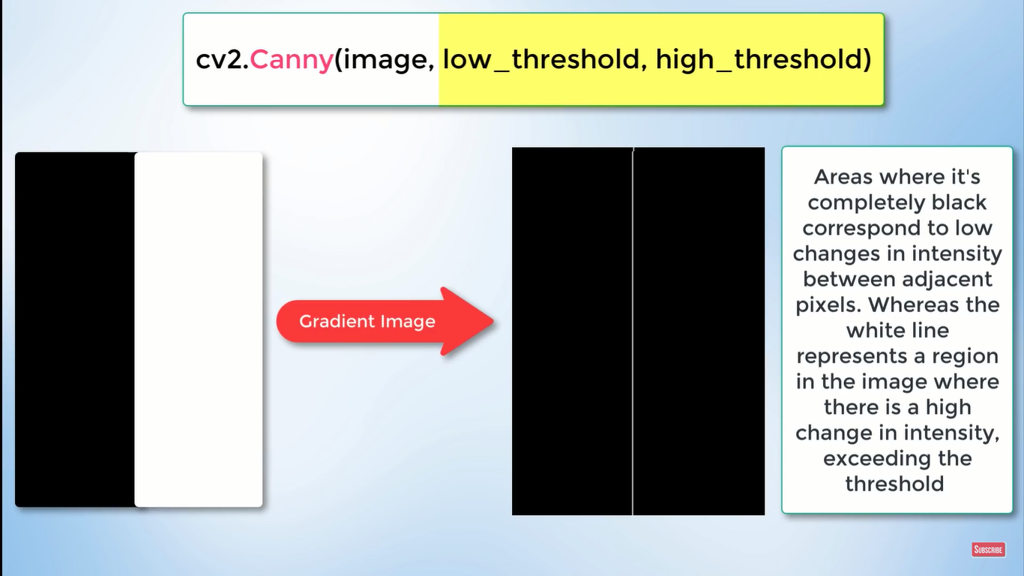

Slide 13
Region of interest

Slide 14
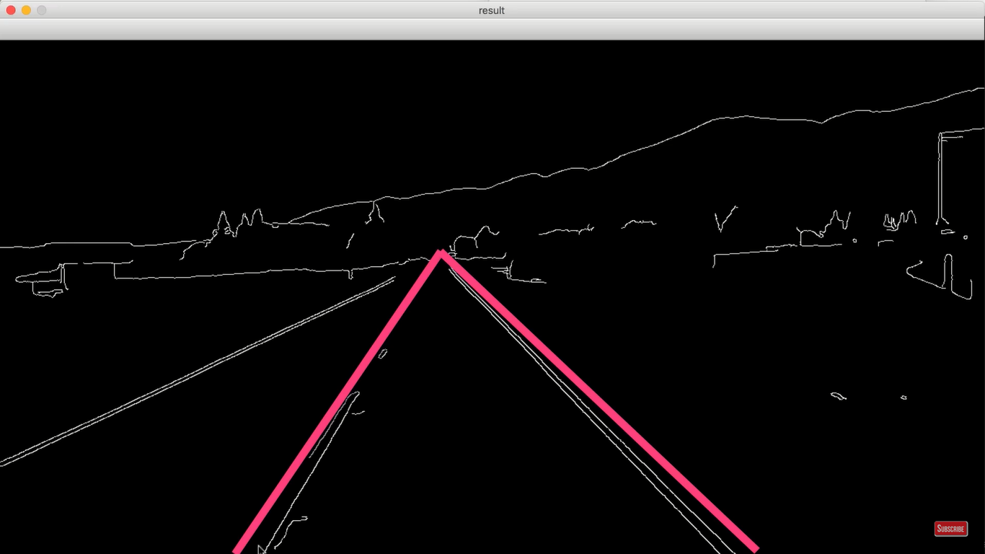

Slide 15
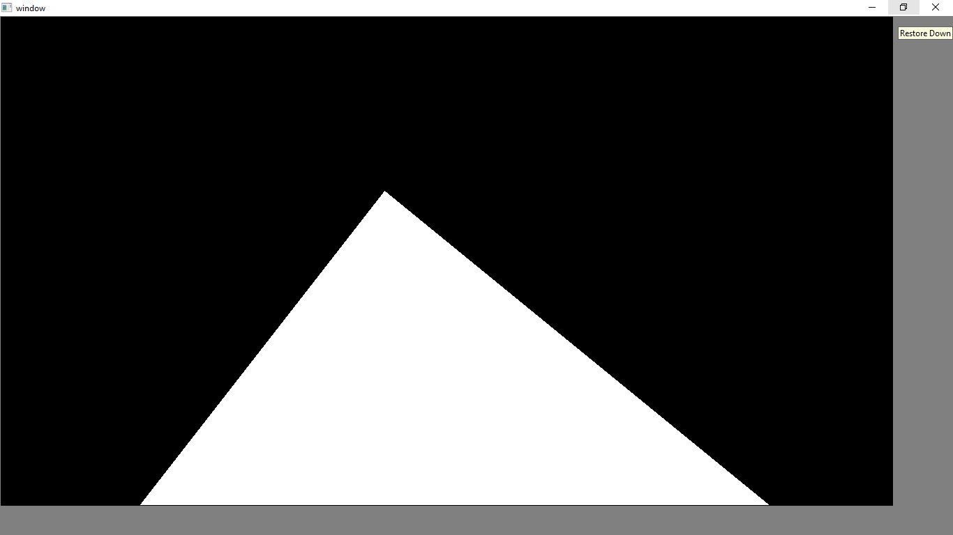
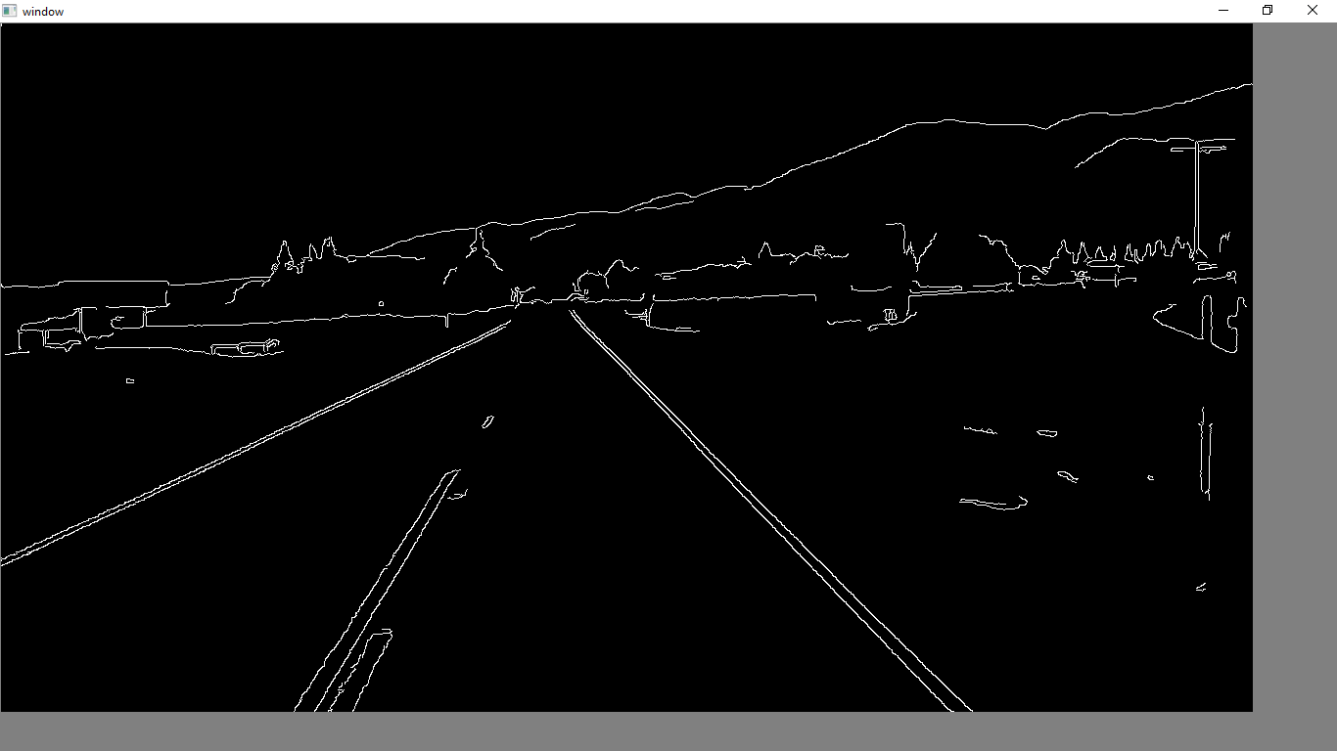
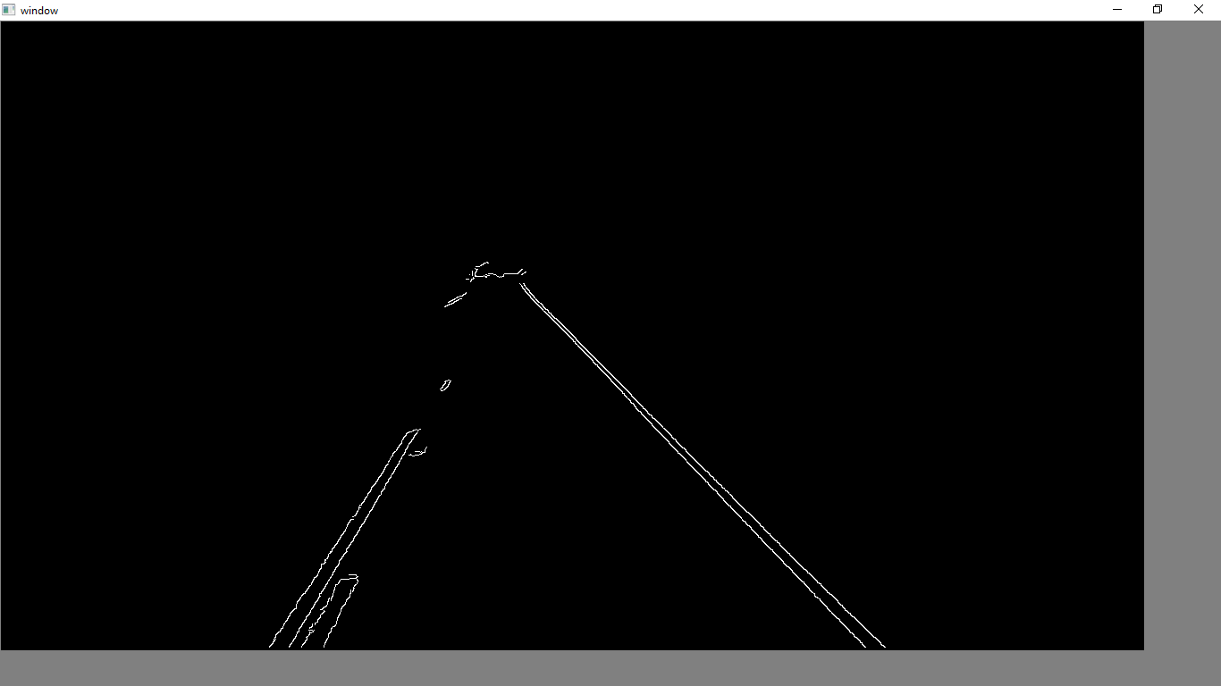

Slide 16
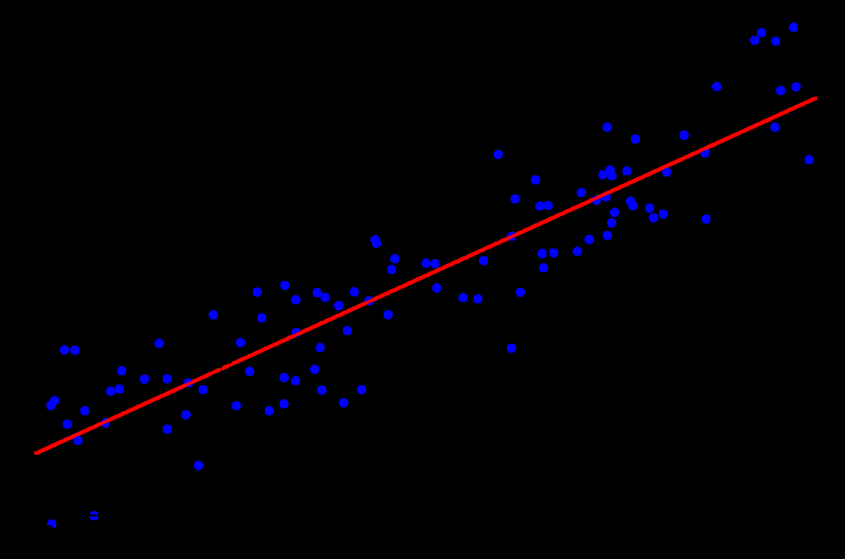
Linear Regression

Slide 17
Thank you

